Slide 1

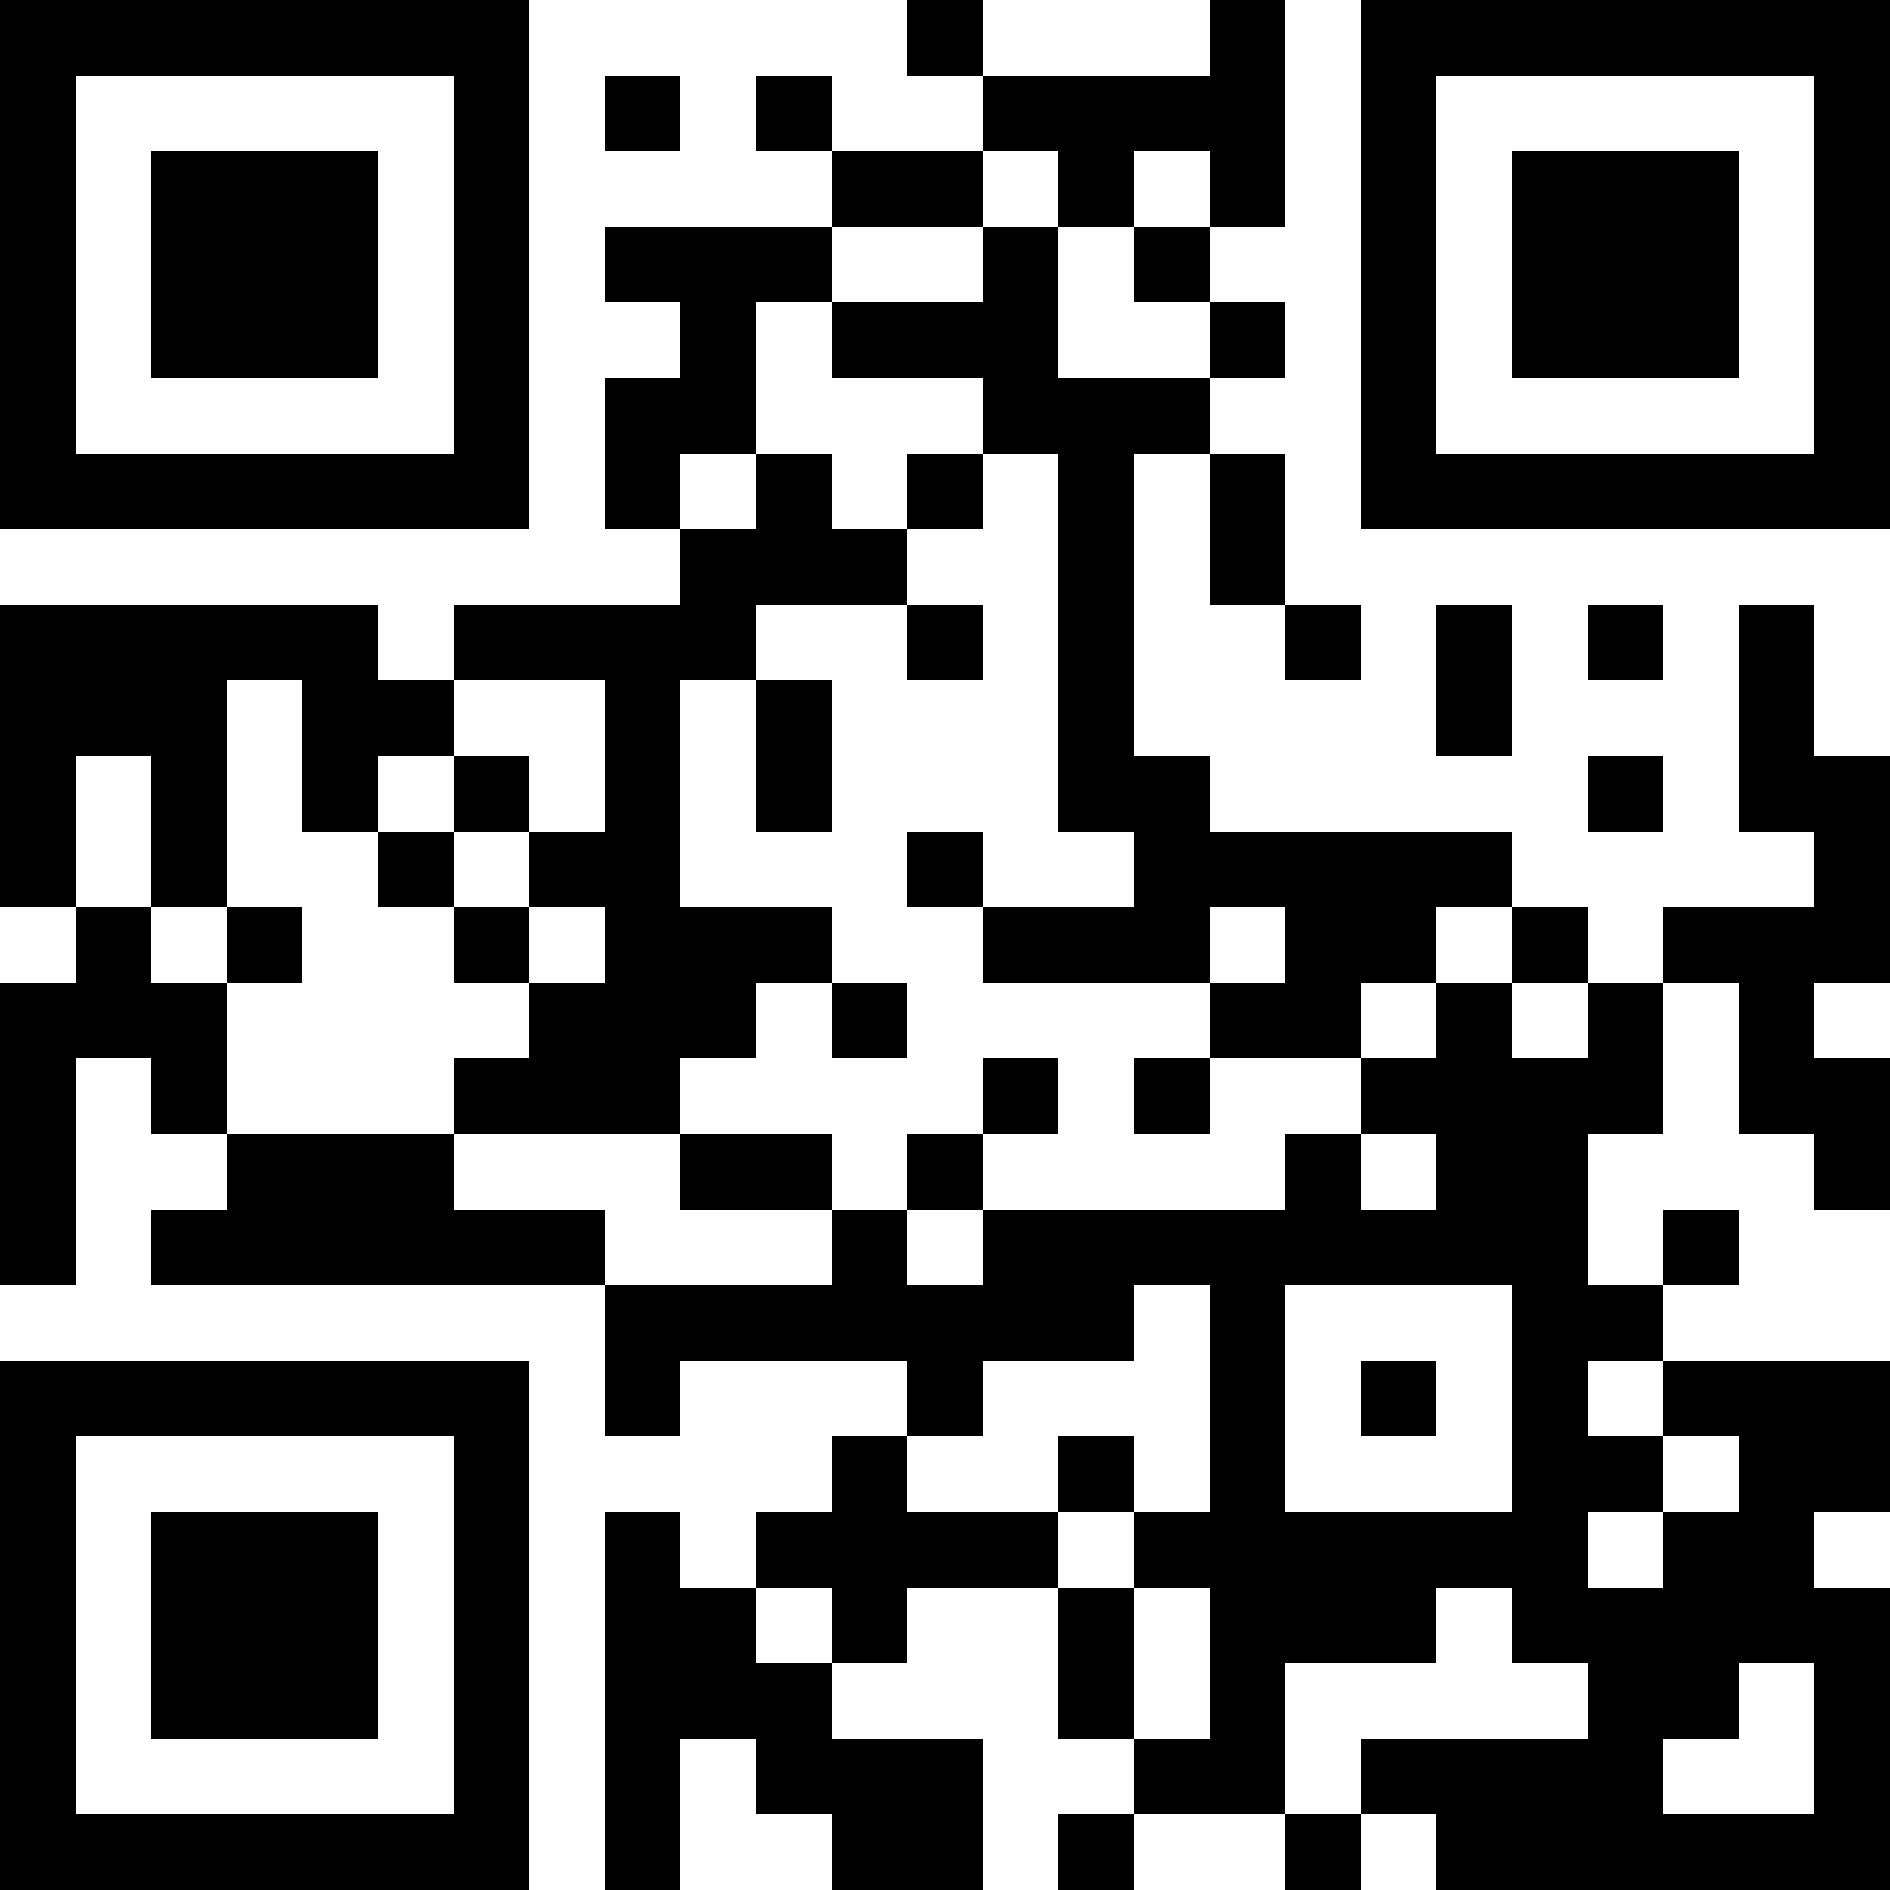



WELCOME!
Hacking Rooms ABH 003 & 004
11th Annual UMSL
WOMEN’S HACKATHON
JOIN THE DISCORD for updates and resources:
Empowering #WomenInTech
2025
Brought to you by
Guest Wi-Fi Access:
Network: TritonNetGuest
ID: sbusmis@sbusmis.com
Password: 64448

Slide 2
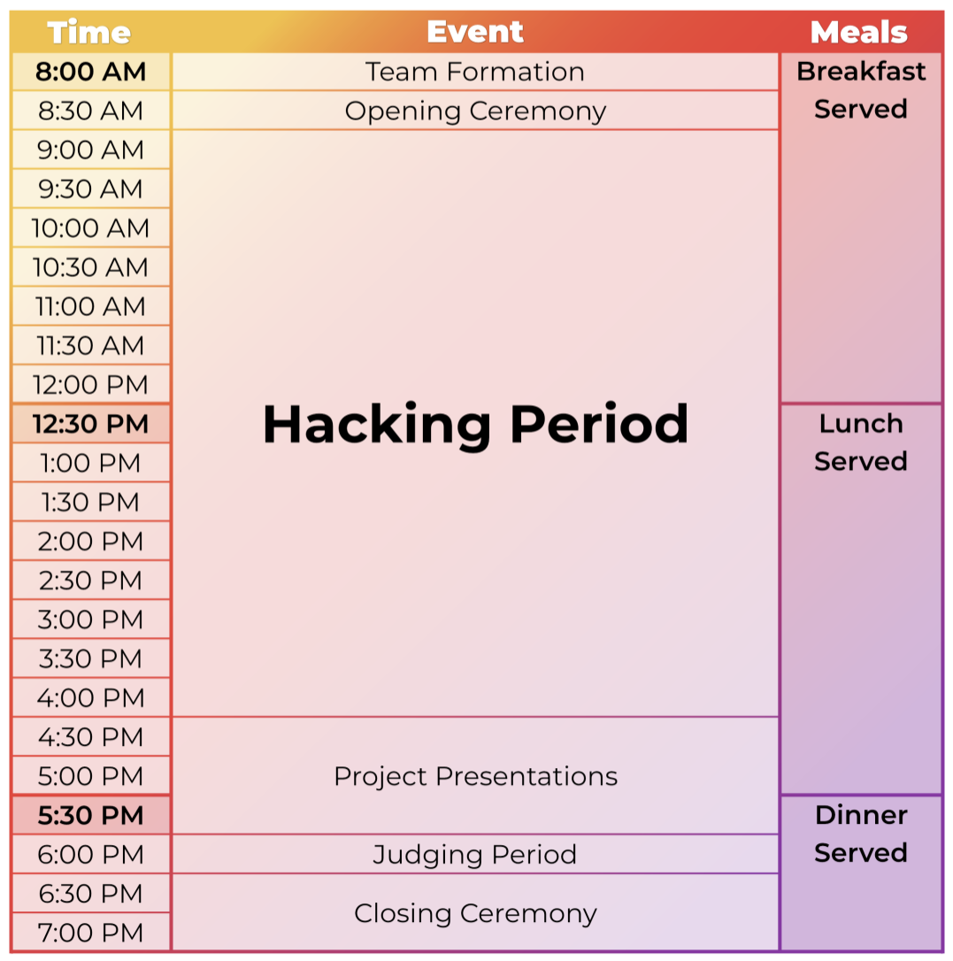
TIMELINE SUMMARY
Breakfast – 8:00 AM
Lunch – 12:30 PM
Dinner – 5:30 PM
Keynote Speech – 8:30 AM
Presentations – 4:30 PM
Winners Announced – 6:30 PM
UMSL WOMEN’S HACKATHON 2025

Slide 3
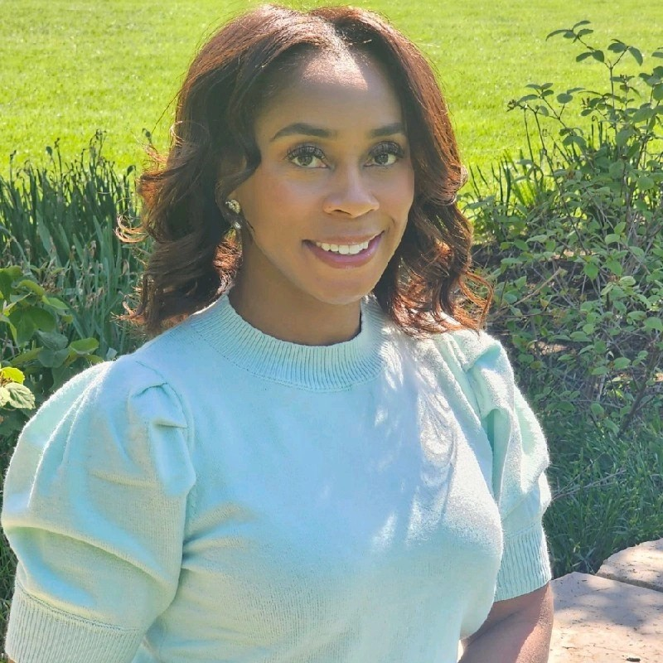

Reinsurance Group of
America, Incorporated
rgare.com
Thank You All!
Geminia Morris
Keynote Speaker
This event is not possible without Sponsors, Mentors, Judges, Volunteers and Participants. Thank you all!
UMSL WOMEN’S HACKATHON 2025

